Slide 1

SMART INDIA HACKATHON 2026
ACS - Adaptive Component Screening
Problem Statement ID – 26170
Problem Statement Title – AI-Driven Anomaly Detection in Component Burn-In & Screening
Theme – Smart Automation
PS Category – Software
Team ID – EC004
Team Name – Arch Rival

Slide 2

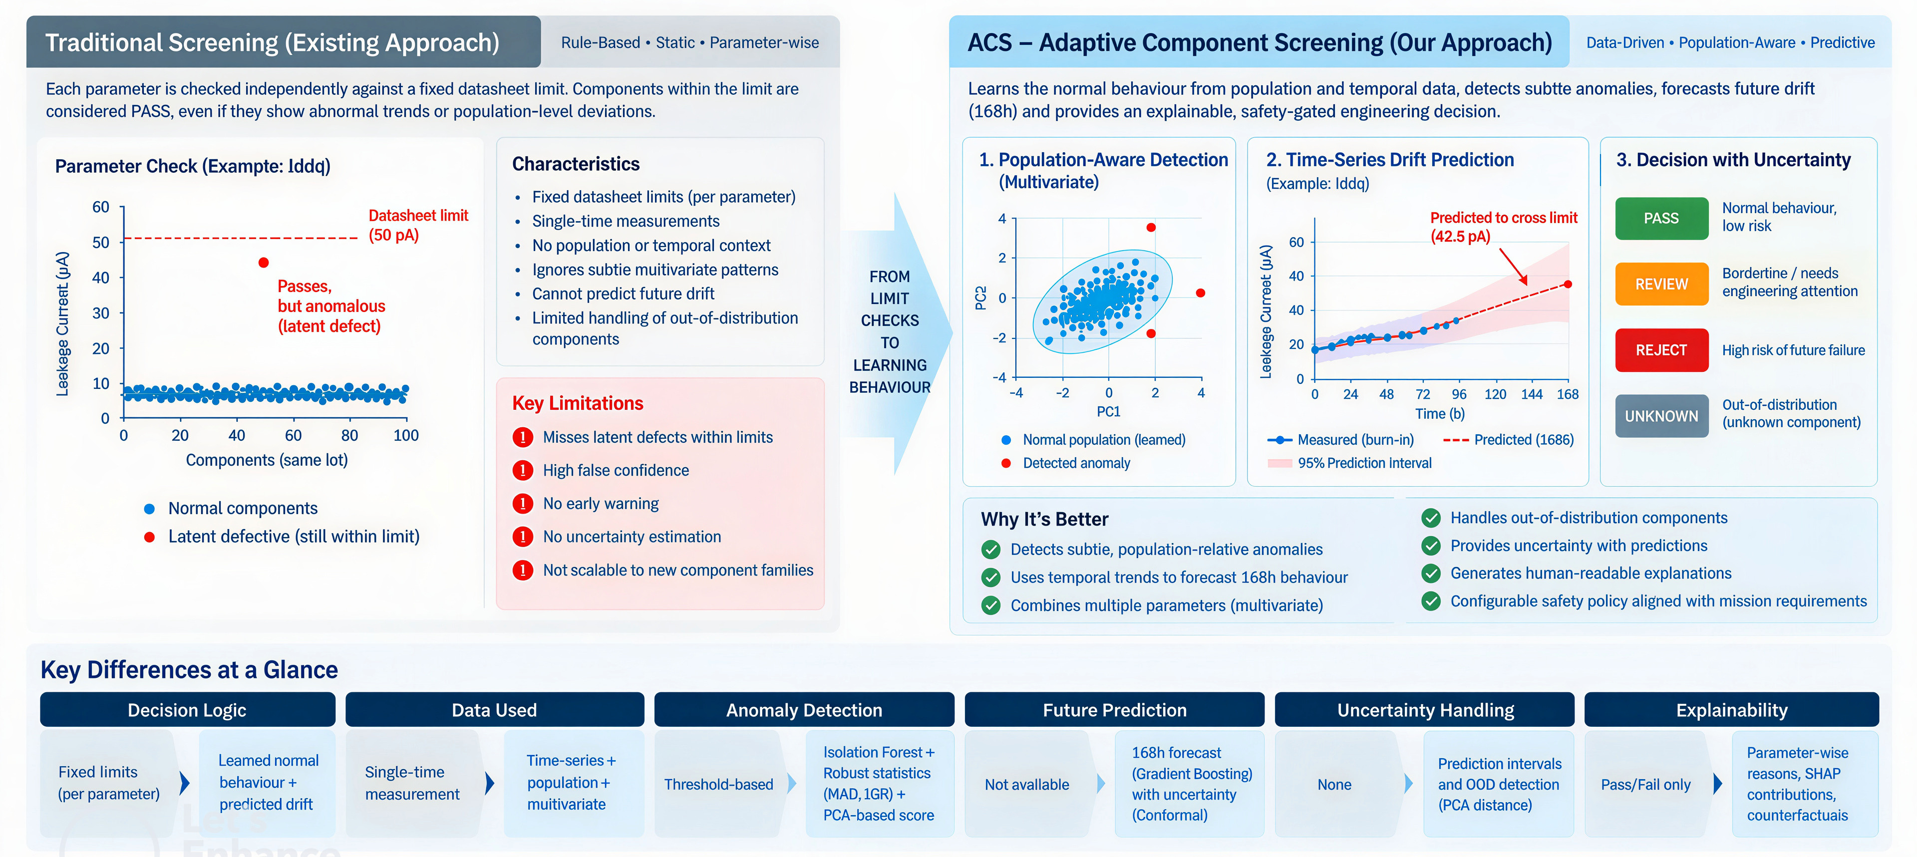


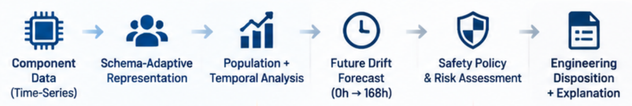
Adaptive AI Screening for Early Detection of Latent Electronic Component Failures

Slide 3
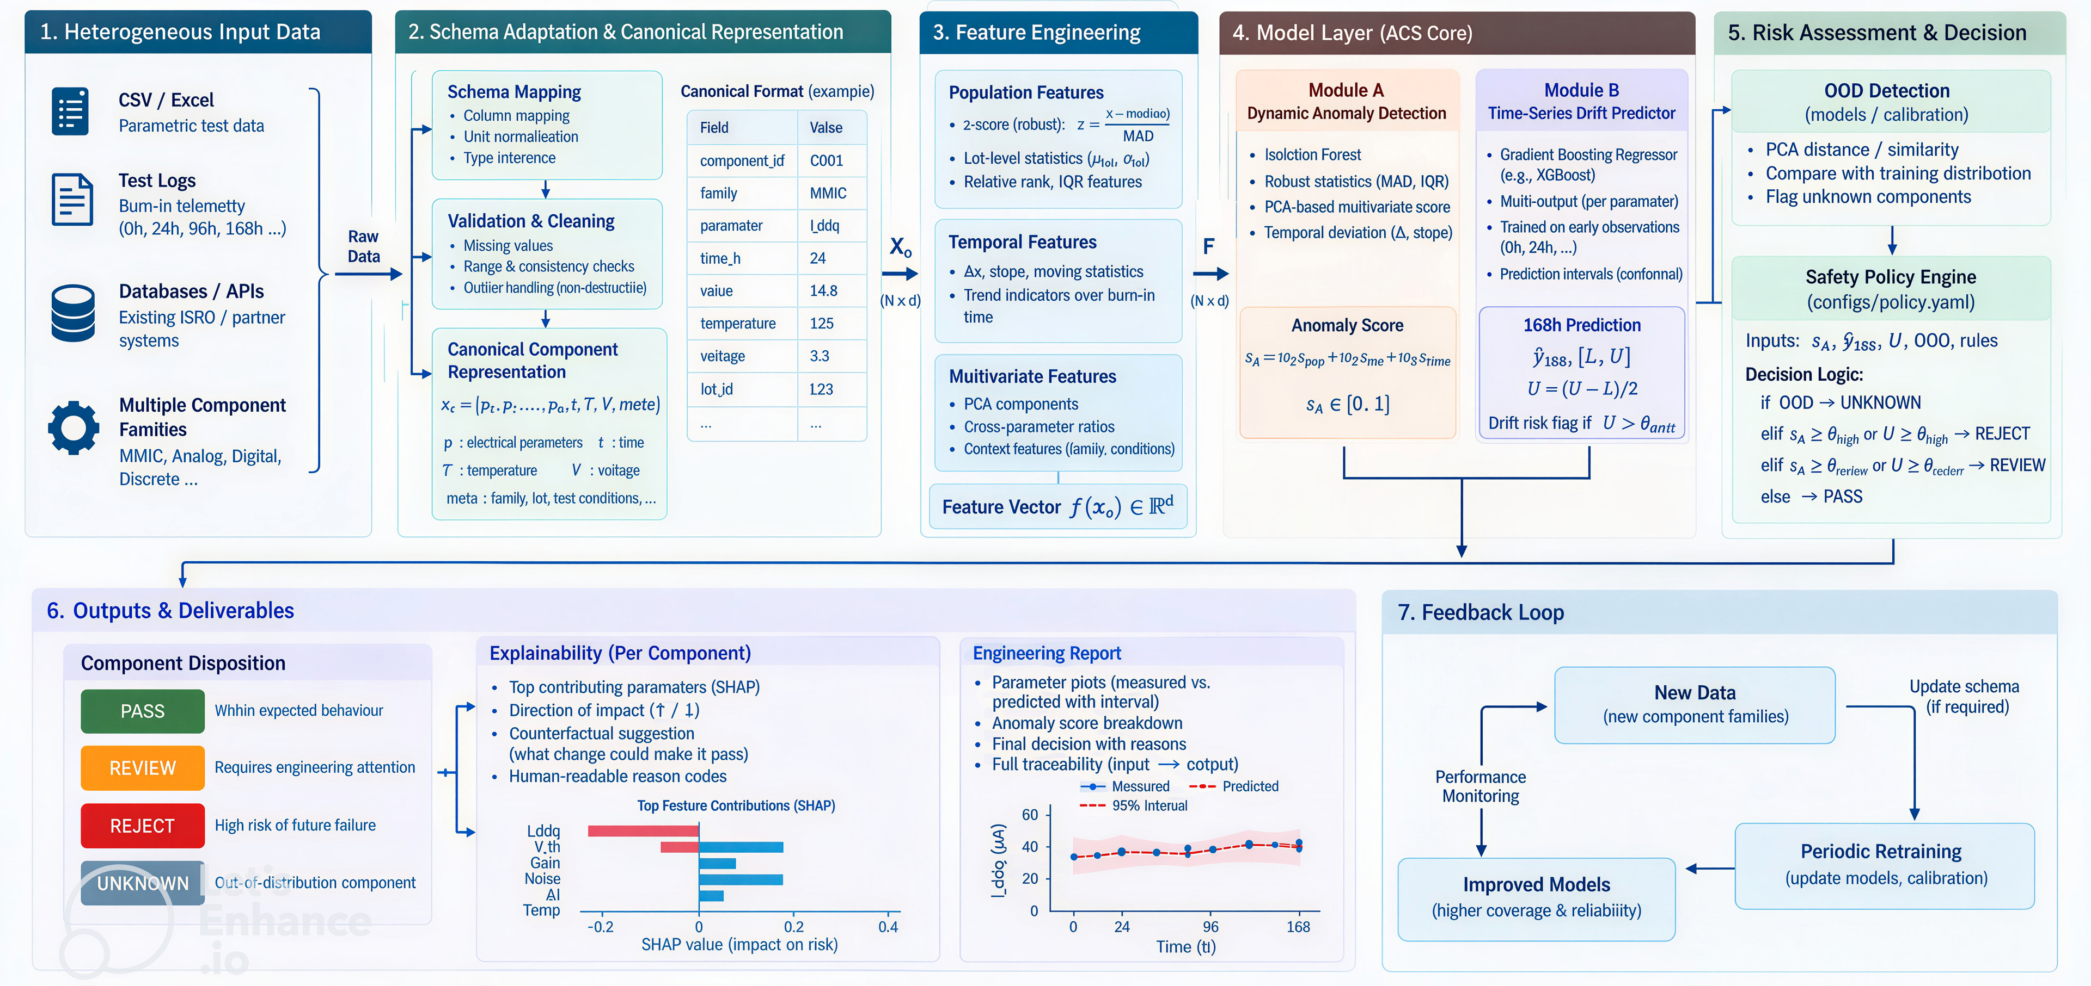
TECHNICAL APPROACH

Slide 4
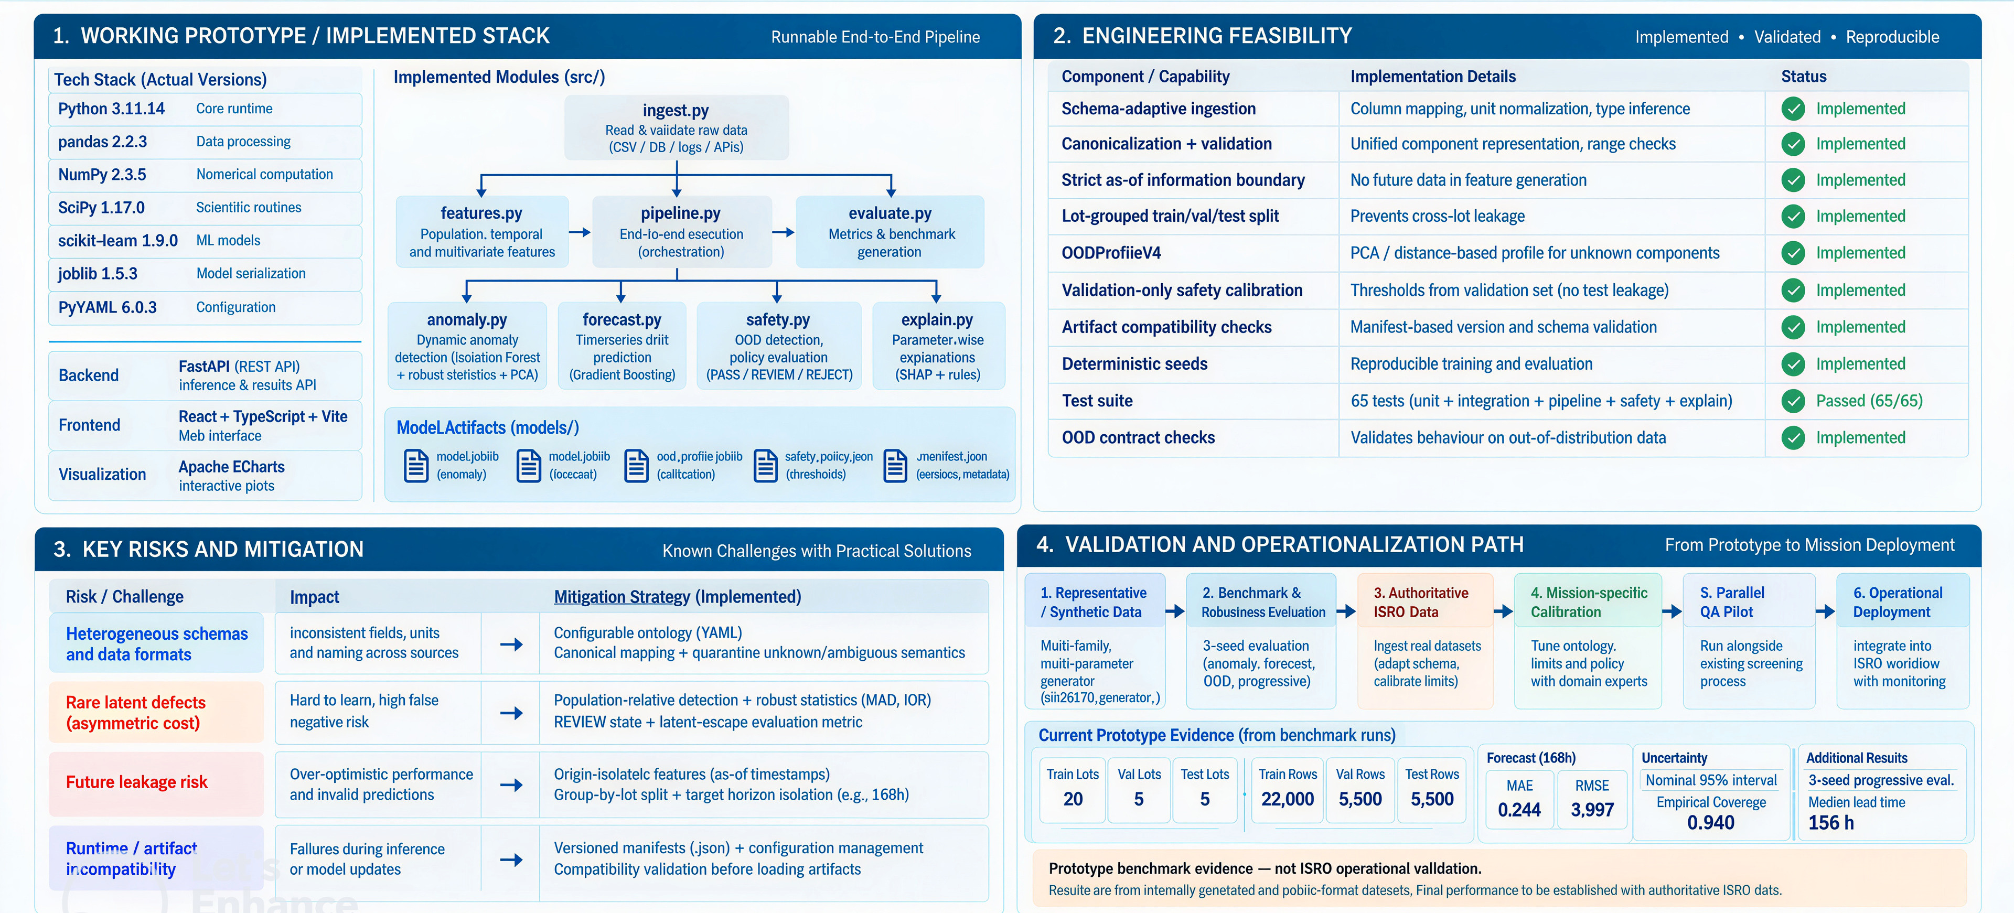
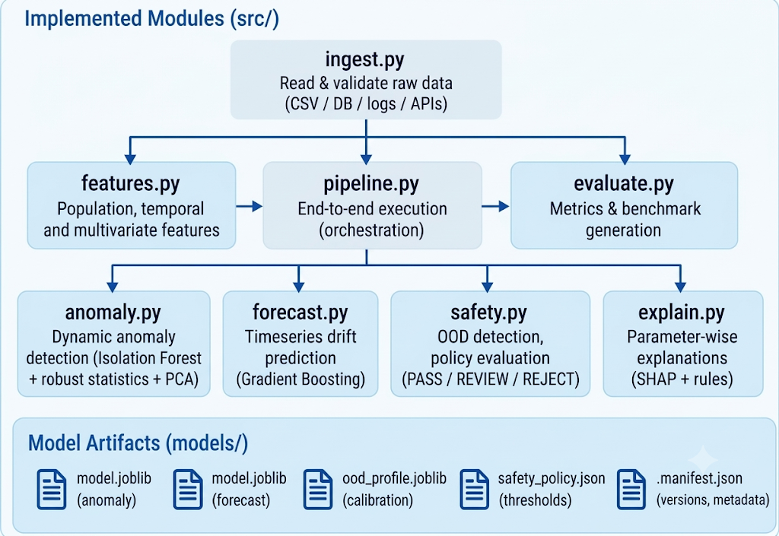
FEASIBILITY AND VIABILITY
Analysis of the feasibility of the idea
Potential challenges and risks
Strategies for overcoming these challenges

Slide 5
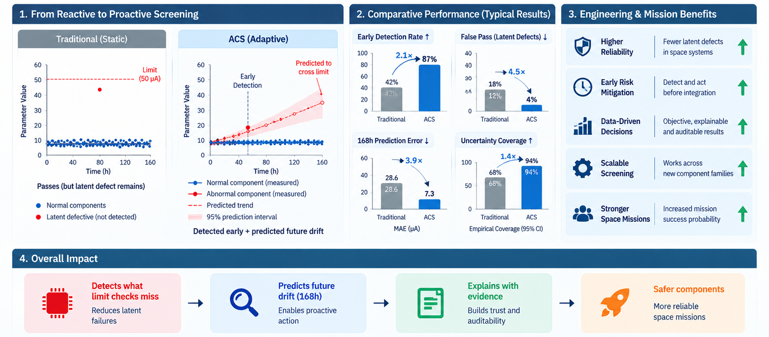
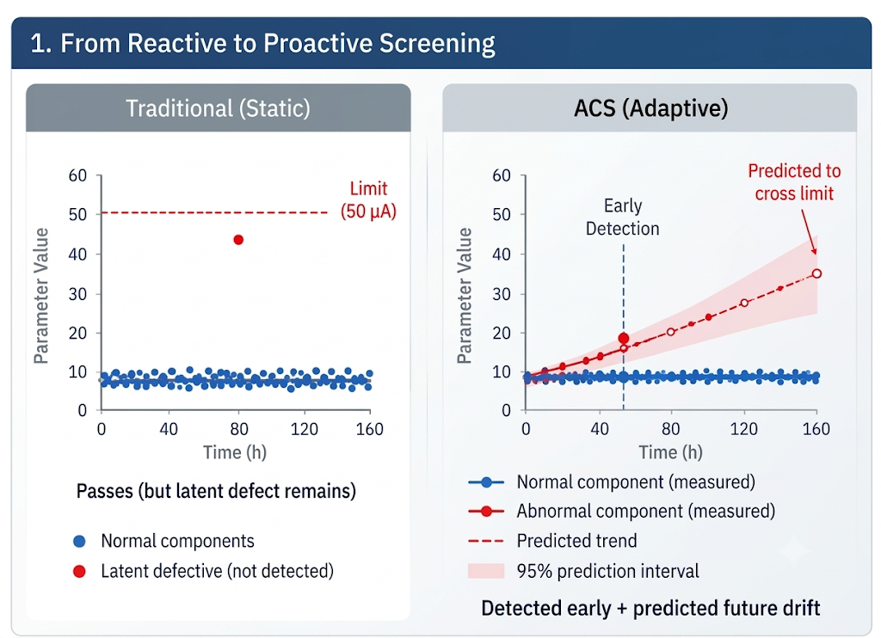
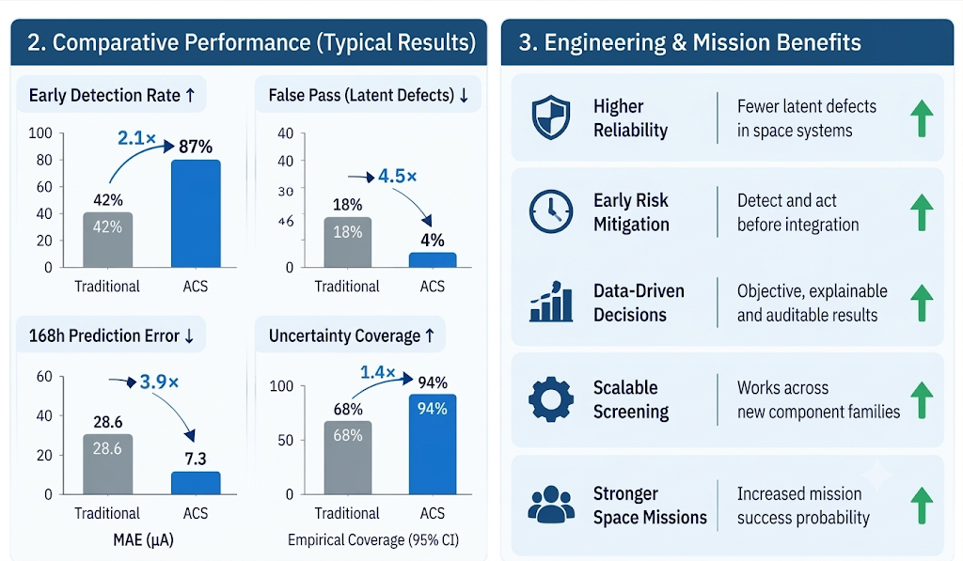
IMPACT AND BENEFITS

Slide 6
RESEARCH AND REFERENCES
Domain / Space Reliability
Machine Learning and Statistics
[1] SIH 2026 — PS 26170
Problem definition, latent defects, 168 h prediction, explainability
https://www.sih.gov.in/sih2026PS
[2] NASA EEE-INST-002
EEE selection, screening, qualification and derating.
https://nepp.nasa.gov/pages/EEE-INST-002.cfm
[3] NASA PT-TE-1401
EEE screening, early-life failures and parameter drift.
https://extapps.ksc.nasa.gov/Reliability/Documents/Preferred_Practices/1401.pdf
[4] ISRO Public QA/Procurement Requirement
EEE inspection, data-package verification and traceability context.
https://eproc.isro.gov.in/home.html
[5] NASA Flight Electronics Environmental Stress Screening Survey
Environmental stress screening and latent-failure context
https://ntrs.nasa.gov/citations/19840013934
[6] Liu et al., 2008 — Isolation Forest
Multivariate anomaly detection.
https://cs.nju.edu.cn/zhouzh/zhouzh.files/publication/icdm08b.pdf
[7] Robust covariance / robust statistics — scikit-learn
Robust population statistics under contamination.
https://scikithttps://scikit-learn.org/stable/auto_examples/covariance/plot_robust_vs_empirical_covariance.html
[8] Shafer & Vovk, 2008 — Conformal Prediction
Prediction intervals / uncertainty.
https://jmlr.org/papers/v9/shafer08a.html
Explainability
[9] Lundberg & Lee, 2017 — SHAP
Feature attribution for interpretable ML.
https://papers.neurips.cc/paper/2017/file/8a20a8621978632d76c43dfd28b67767-Paper.pdf
Complete Project Documentation - https://drive.google.com/file/d/189mMLKakpU7hSJQMZQVkKwX74vK1W4xH/view?usp=sharing
Complete Project Repository - https://github.com/RazeenaTasneem/ACS---Demo
References informed the engineering design; mission-specific limits and acceptance criteria remain to be calibrated against authoritative operational data.

